Slide 1
Missing and Murdered Indigenous Women and Girls Initiative
Supporting Families of Missing or Murdered Persons
Victim Services, Alberta Justice and Solicitor General, Alberta Government in partnership with Government of Canada

Slide 2
“One woman goes missing, then another, then another. For a long time only those who know and love them pay attention. Until the numbers start to add up.”
Finding Dawn

Slide 3
Alberta’s MMIW Initiative
Purpose
Engage Indigenous communities
Examine resources, policies and practices
Identify system gaps and needs
Look at geographical considerations
Survey victim services, police services and community organizations
Identify and advance recommendations
Notes:
Base line data – who is missing in Alberta, where are they from and where did they go missing from?
Geographical – are their contextual considerations that impact this phenomena?
Supports – what do families need to help them? What already exists and what needs to be created?
System gaps = how is Alberta doing with their overall response?
Laws & Policies – is required legislation in place? Do all families receive the same response? Are their systemic inequities?
Engagement about cultural safety needs – Aboriginal people over represented as victims of crime in general. How can we provide better service that meets their needs and results in a better, more helpful experience?
Disseminate information – need to share what is already known; the gains that have been made, how this issue impacts communities from a safety perspective, build capacity through education
Framework development – ensure there is a consistent, quality response delivered in a culturally safe manner to (aboriginal) families who have lost loved ones
Indigenous research methodology: honouring protocols, recognition that Indigenous people often the subject of research but rarely benefit from it, reciprocity, recognition that I am accountable as a researcher not only to JSG but also to the community and all my relations)
Mixed methods study (written responses [186] + community engagement [575 participants] + stakeholder engagement [28+ meetings] )
2013 to 2015 Total: 27 months
14 communities which included 11 Indigenous nations and 3 communities with a large Indigenous service area (Lethbridge, Lac La Biche, High Level)
Included a geographical scan to understand where woman went missing from & where their home communities were (geographical nuances)
Environmental scan to determine existing supports & services and also gaps in service
Police services response to homicide and missing – 30 questions (examination of current laws and policies)
Interviewed a number of family members impacted, both missing & homicide
Personally tracked a couple of missing persons reports

Slide 5
What’s Being Done
Two positions have been hired to ensure recommendations are implemented
Provincial homicide family liaison
Provincial missing person coordinator
Shared findings to increase awareness
Presentations throughout the province to police, victim services, support agencies, court services, communities
Missing persons awareness campaign
Address myths around missing persons
Distributed to over 2000 people

Slide 6
What We Heard: Police Response
Long response times in some remote communities
Fear of retribution and lack of anonymous reporting
Feel the police had pre-conceived assumptions about complaints from an Indigenous person.
Fear of police response to a report of violence or a missing person, especially if removal of a loved one
Perception that police “only show up when there’s trouble”
Perception that most police do not understand the historical impacts and the personal (community) history of the people
Experience police not taking missing persons reports
Notes:
Community members did have a fair bit to say about the police response:
Police focus is on the investigation itself so they may not appear as supportive to families who are going through crisis. In some instances, they may not be aware of families who are not be able to deal with crisis effectively (drug/alcohol use, dysfunctional).
The length of time between when a loved one is last seen to the time the missing person’s report is filed.
Re: Limited contact with families (preference to work with only one point of contact – recognition of kinship issues
Youth:
Gaps regarding children in care – chronic runaways – a special kind of ‘missing’ that is a challenge to deal with operationally

Slide 7
What’s Being Done
Police Advisory Committee on Missing Persons
Representatives from each police force and victims services across Alberta
Ensure services provided to families of missing people are robust, appropriate and culturally safe
Legislation Changes
Amend Missing Persons Act to ensure police have authority to locate missing person in a timely manner
Changes currently awaiting legislative approval
Referral process
A review of the referral process from police services to victim services for missing persons and homicide is underway.
This will guide a standard policy between police and victims services for missing persons and homicide

Slide 8
What We Heard: Victims Services
There are not enough Indigenous victims’ advocates
Missing persons is not within Victims Services scope
Underservice youth
Limited resources for complex needs
High turnover of staff and volunteerism is tricky
Lack of funding for counselling for families of missing and murdered
Financial Benefits are dependent on criminal history of victim
Concerns about privacy and anonymity
Lack of awareness of victims services
Lack of consistent practice across the province

Slide 9
What’s Being Done
Family information liaison unit
All Indigenous staff
Work directly with families of missing or murdered Indigenous women and girls
Help families navigate government systems to obtain information from police, courts, child services, medical examiner and other agencies
Provide culturally safe emotional support and ceremonial opportunities for the family
Regionalized – travel into the remote communities of the province to provide supports to families who do not have access to the urban centers

Slide 10
Indigenous Victims Outreach Specialists (IVOS)
Targeted outreach initiative
Goal is to have a consistent Victims Services in community to build trust, increase indigenous access to services and provide culturally safe practice
First two positions were created in 2007, a third added in 2011
We now have eight IVOS positions throughout the province

Slide 11
Funding
Victims Services is currently conducting a review of the Victims of Crime legislation and funding process which will affect services and funding for families
Recent announcements were made announcing increased funding for the busiest Victims Service Units
This includes a further $1,000,000 for the Indigenous Victims Outreach
Healing gathering for families
To bring families together in a safe place where they can share what is helpful and meaningful for them in understanding the loss of their loved one
Creation of ambiguous loss training
Ambiguous Loss is a type of grief that is different from other types of grief. We are working to develop training for all provincial partners who support the families of missing persons

Slide 12
Missing persons peer support groups
coordinating with community partners and loved ones of missing persons to establish missing persons peer support groups
Professional Guides
Developing guides to assist victims services in supporting families of the missing and murdered
Working to include information on youth and complex needs
Working with Alberta Health Services to develop ambiguous loss training

Slide 13
What We Heard: Cultural Safety

Slide 14
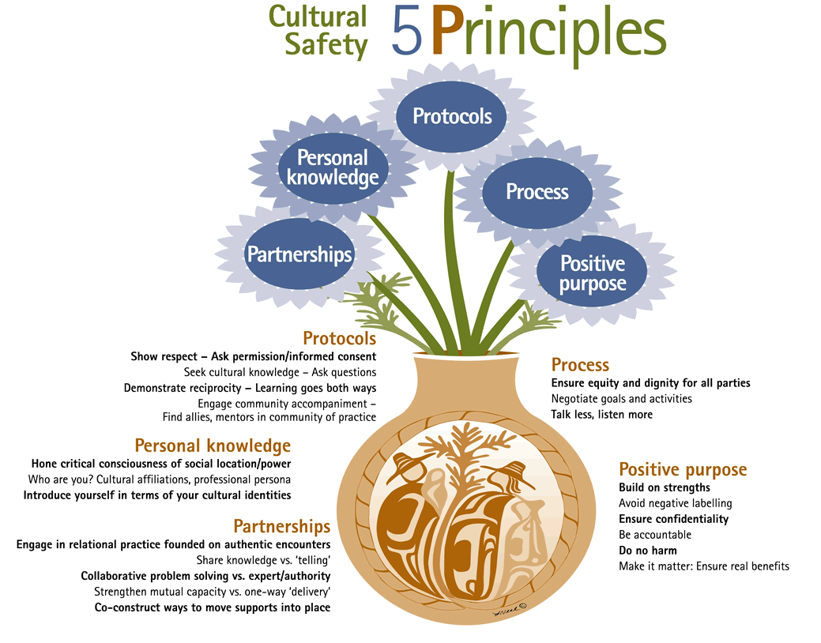
Jessica Ball, M.P.H., Ph.D. Cultural Safety in Practice and With Children, Families and Communities, University of Victoria
Notes:
Partnerships means engaging in relational practice based on authentic encounters; problem solving is collaborative and builds on the strengths of the client and the community
Personal Knowledge Service provider is mindful of their cultural identity and history relative to client, personal cultural values and beliefs.
Protocol Principle demonstrate a commitment to honoring protocol showing respect and curiosity to learn more
Process recognition of the client’s gifts and strengths and their need to be involved and empowered in determining the direction of their own future.
Positive purpose Indigenous people and Indigenous communities have continued to demonstrate resilience; identifying what these resiliencies are ensures there is a foundation for program continuity and growth.

Slide 15
What is Being Done: Cultural Safety Training
Presentations to Victims Services staff and volunteers across the province to ensure culturally safe service delivery
Created mandatory on-line training for all Victims Service
Continue to work with the police to ensure they are aware of issues identified in the report and their behaviour is culturally safe
Work is currently underway to expand cultural safety training to include Alberta Crown Prosecution Services, Court Services, and police services throughout the provinces.

Slide 16
Increased Focus on Safety and Prevention
Safer Communities Initiative
A partnership was developed with non-profit and private sector to offer an easy-to-use phone app to help protect vulnerable people.

Slide 17
Safer Communities Initiative

Slide 18
Who Can Benefit from the Program?
Any individual who may be at risk for violence for any reason:
Walking alone
Domestic Violence
Hitch-hiking
Sex work
Any other risk…
Any support agency staff who work remotely, travel, perform outreach or conduct home visits
Anyone with an android or Apple smartphone with data or wifi

Slide 19
A Little About the Program:
It’s a phone app that provides emergency back-up to individuals at risk – for any reason
It connects the client to a response centre, staffed by indigenous women from the Gitxsan nation – in real time
GPS locations are sent every 5 minutes when a client is logged in
The client location is only available when they log in – they choose when to connect
All information is protected and kept private – unless an emergency response is necessary – then the GPS location and any entered notes/images are shared for emergency response
Offers a connection to a support network who can follow up with the client should an emergency occur
There is no cost to any client or support agency

Slide 20
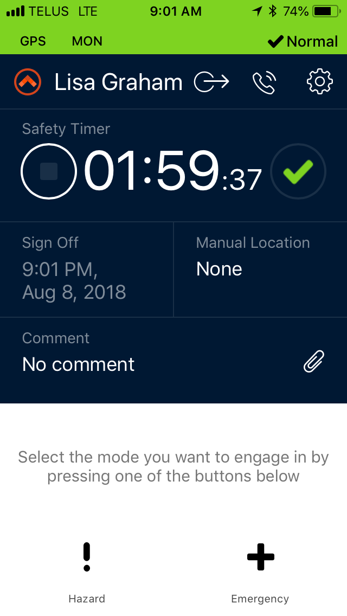
Three Main Components
Countdown timer
When risk is moderate
Hazard timer
When risk is increased
Can be set from 10 minutes
to 2 hours by the client
Emergency button
Immediate notification to
to emergency services

Slide 21
What If They Don’t Check In?
The client will be notified through the app before their safety timer expires. If they do not check in before it does:
At check in time: a text will be sent to the client asking them to check in and 15 minutes grace period given
At 15 minutes: they will be called and a second text sent
At 20 minutes: they will be called a second time. If they do not answer, their emergency contact will be called
At 25 minutes: they and their emergency contact will be called again
At 30 minutes: the police will be called and notified of their last known whereabouts and asked to respond.
The assigned agency is notified to follow up for any necessary aftercare

Slide 22
What Information is Needed to Get Started?
First and Last name
Cell Phone Number
Email address
Email the above information to:
Lisa.Graham@gov.ab.ca or
Safercommunities@Ignitech.org
The client will receive a confirmation email with directions on creating a password

